Slide 1
Ecosystems: Lesson 4, Activity 3
Carbon Pools and Fluxes

Slide 2
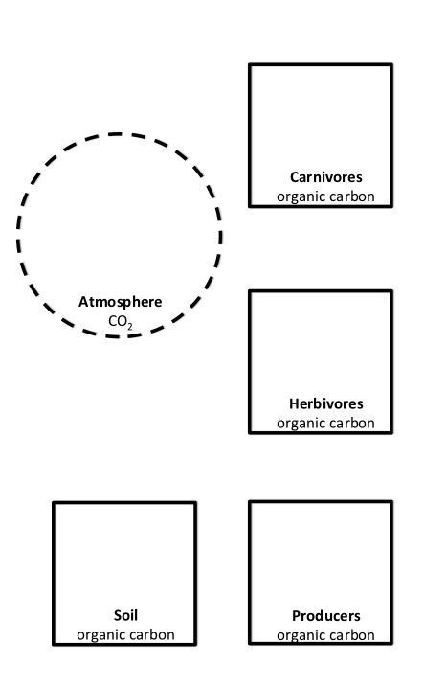
Inorganic vs organic
Let’s simplify things…..
instead of having 5 carbon pools (atmosphere, producer, herbivore, carnivore, soil), let’s look at just 2 carbon pools: organic and inorganic.

Slide 3
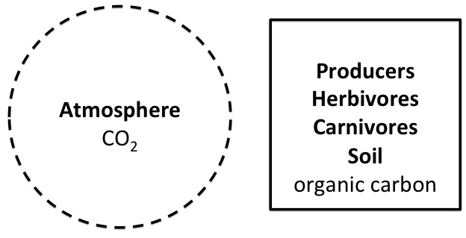
Inorganic vs organic
These two pools represent:
Inorganic carbon that is in the atmosphere in the form of CO₂
Organic biomass that is stored in the producers, herbivores, carnivores, soil, and other living parts of the ecosystem

Slide 4
Inorganic vs organic
You will track carbon atoms moving back and forth between the inorganic pool of carbon in the atmosphere, and the organic pool of carbon in the biomass.
Photosynthesis
Cellular Respiration

Slide 5
Fluxes
The amount of carbon that moves per unit of time is called a “flux”. We will examine one year of time that passes.
So you will record the number of carbon atoms that move between pools per year
Photosynthesis
Cellular Respiration

Slide 6
Carbon Pools Change Size Over Time
If the organic pool has more carbon atoms, that means there are more living things in the ecosystem!
(More biomass and soil organic carbon exists, so more plants & animals)
Photosynthesis
Cellular Respiration

Slide 7
Round 1
During this year, fluxes are balanced!
So photosynthesis happens at the same rate as respiration.
Photosynthesis
Cellular Respiration

Slide 8
Round 1: Fluxes are balanced
Place 400 carbon atoms in the organic carbon pool.
Place 800 carbon atoms in the atmosphere pool.
Every year 200 carbon atoms are photosynthesized.
Plants grew!
Every year 200 carbon atoms are respired.
Plants respire, are eaten by herbivores who then respire, plants die and respired by decomposers.
Photosynthesis
Cellular Respiration

Slide 9
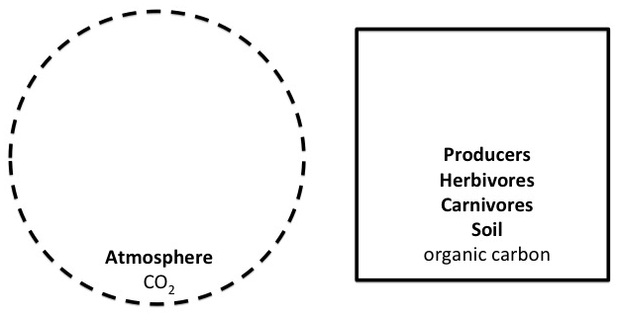
Round 1: Fluxes are balanced
Predict how pool sizes will change after a few years
200 per year
Photosynthesis
400
800
Cellular Respiration
200 per year

Slide 10
Round 1: Fluxes are balanced
End of year 1:
Inorganic pool
800 – 200 + 200 = 800
Organic pool
400 – 200 + 200 = 400
200 per year
Photosynthesis
400
800
Cellular Respiration
200 per year

Slide 11
Round 1: Fluxes are balanced
End of year 2 (still the same!):
Inorganic pool
800 – 200 + 200 = 800
Organic pool
400 – 200 + 200 = 400
200 per year
Photosynthesis
400
800
Cellular Respiration
200 per year

Slide 12
Round 1: Fluxes are balanced
In the first round, the flux of photosynthesis is equal to the flux of cellular respiration in the ecosystem.
Where is most of the carbon in this round: In the organic pool or the inorganic pool?
How did the organic and inorganic pools change over time?
At the end of the year, did the ecosystem get bigger (more plants and animals)?

Slide 13
Round 2
Some trees were planted in an abandoned cornfield!
So photosynthesis happens at a faster rate than respiration. The result is trees growing and getting bigger. Soon there will be a forest!
Photosynthesis
Cellular Respiration

Slide 14
Round 2: Trees planted
Place 400 carbon atoms in the organic carbon pool.
Place 800 carbon atoms in the atmosphere pool.
Every year 300 carbon atoms are photosynthesized.
Every year 200 carbon atoms are respired.
Photosynthesis
Cellular Respiration

Slide 15
Round 2: Trees planted
Predict how pool sizes will change after a few years
300 per year
Photosynthesis
400
800
Cellular Respiration
200 per year

Slide 16
Round 2: Trees are planted
End of year 1:
Inorganic pool
800 – 300 + 200 = 700
Organic pool
400 – 200 + 300 = 500
300 per year
Photosynthesis
500
700
Cellular Respiration
200 per year

Slide 17
Round 2: Trees are planted
End of year 2:
Inorganic pool
700 – 300 + 200 = 600
Organic pool
500 – 200 + 300 = 600
300 per year
Photosynthesis
600
600
Cellular Respiration
200 per year

Slide 18
Round 2: Trees are planted
The flux of photosynthesis is more than the flux of respiration in the ecosystem.
Where is most of the carbon in this round: In the organic pool or the inorganic pool?
How did the organic and inorganic pools change over time?
At the end of the year, did the ecosystem get bigger (more plants and animals)?

Slide 19
Round 3
Drought! It hasn’t rained for months and trees are dry and dying
So photosynthesis happens less and respiration happens more.
Photosynthesis
Cellular Respiration

Slide 20
Round 3: Drought
Place 400 carbon atoms in the organic carbon pool.
Place 800 carbon atoms in the atmosphere pool.
Every year 100 carbon atoms are photosynthesized.
Every year 200 carbon atoms are respired.
Photosynthesis
Cellular Respiration

Slide 21
Round 3: Drought
Predict how pool sizes will change after a few years
100 per year
Photosynthesis
400
800
Cellular Respiration
200 per year

Slide 22
Round 3: Drought
End of year 1:
Inorganic pool
800 – 100 + 200 = 900
Organic pool
400 + 100 – 200 = 300
100 per year
Photosynthesis
300
900
Cellular Respiration
200 per year

Slide 23
Round 3: Drought
End of year 2:
Inorganic pool
900 – 100 + 200 = 1000
Organic pool
300 + 100 – 200 = 200
100 per year
Photosynthesis
200
1000
Cellular Respiration
200 per year

Slide 24
Round 3: Drought
The flux of respiration is more than the flux of photosynthesis in the ecosystem.
Where is most of the carbon in this round: In the organic pool or the inorganic pool?
How did the organic and inorganic pools change over time?
At the end of the year, did the ecosystem get bigger (more plants and animals)?

Slide 25
Fluxes of carbon:
Change rates depending on what is happening in an ecosystem
Influence the amount of carbon atoms in pools over time

Slide 26
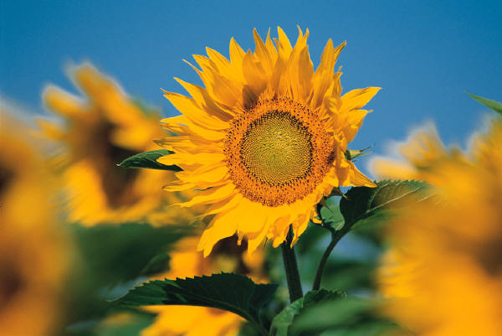
Fluxes of carbon change during seasons
SUMMER:
Plants are growing
Lots of photosynthesis
300
Photosynthesis
700
550
800
400
650
500
Cellular Respiration
150

Slide 27
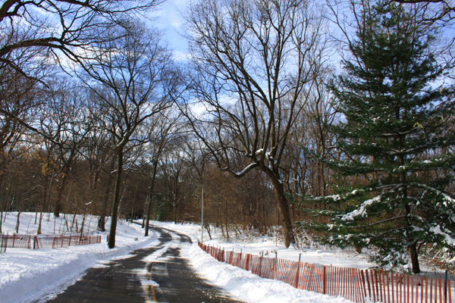
Fluxes of carbon change during seasons
WINTER:
Plants stop growing
Less photosynthesis
50
Photosynthesis
900
450
400
800
300
750
Cellular Respiration
150

Slide 28
So carbon pools change size. Even throughout the seasons of one year!
Photosynthesis
Photosynthesis
550
900
300
650
Cellular Respiration
Cellular Respiration

Slide 29
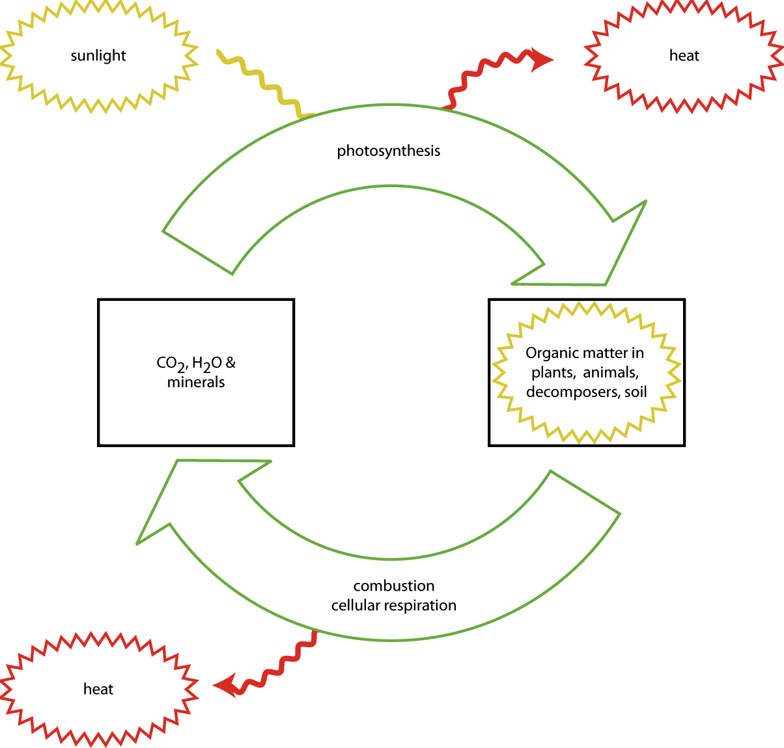
Visualizing Energy

